Slide 1
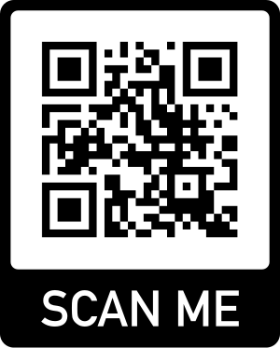
KAZAN NATIONAL RESEARCH TECHNOLOGICAL UNIVERSITY
www.kstu.ru/knrtu/

Slide 2
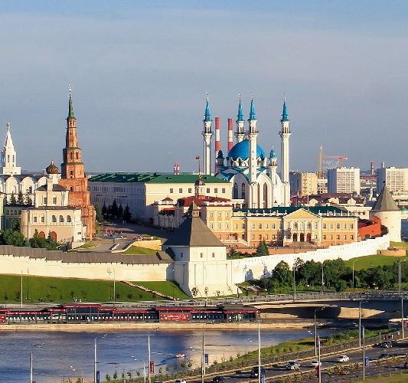
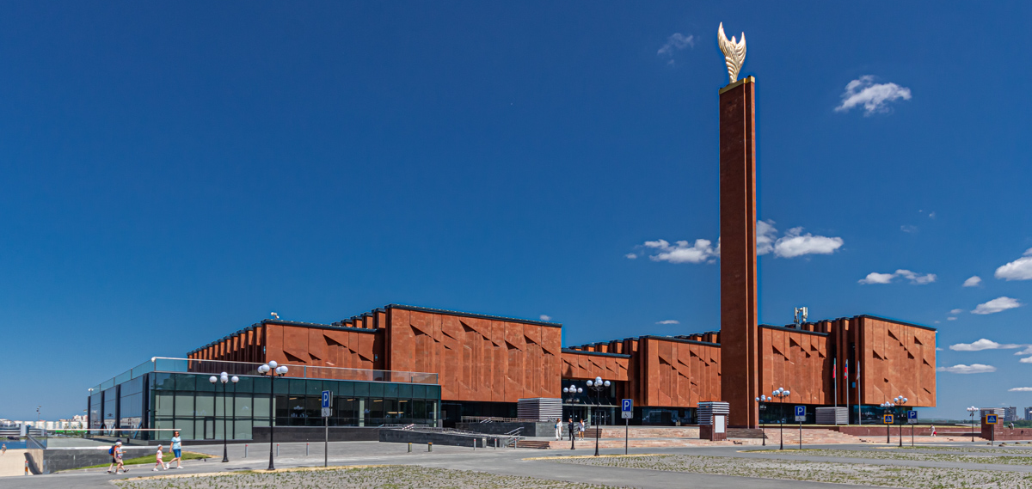
REPUBLIC OF TATARSTAN
Total area 68000 km²
Population
> 3.9M
Universities
44
#5
In Russia by the quality of life
7 Federal investment sites
Tatarstan – the 1st place
(in 2015, 2016 and 2017) in the National
Investment Climate Ranking
2

Slide 3
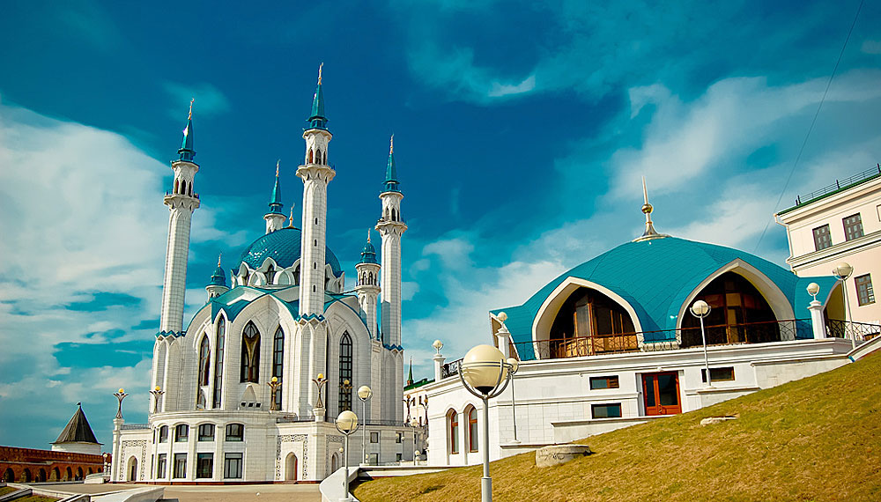
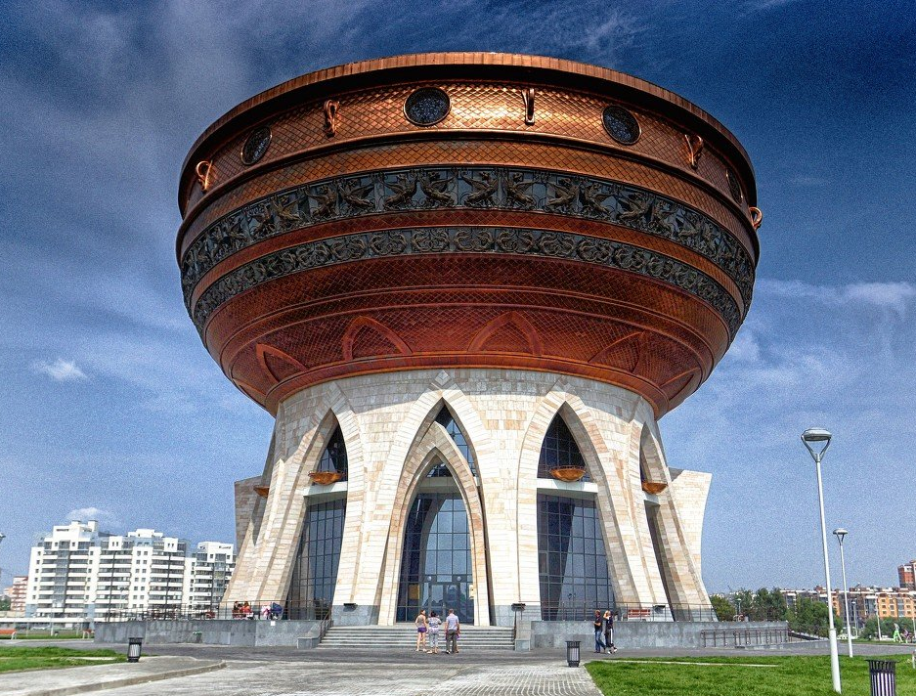
KAZAN
One of the largest economic, scientific, educational, cultural and sports centers in Russia
the population is over
1,250,000
in the list of
UNESCO
World Heritage cities
was founded more than
1,000
years ago
3

Slide 4
OUR HISTORY
Kazan Industrial College
1890
Kazan Institute of Chemical Technology
1930
Kazan National Research Technological University
2010
1919
Kazan Polytechnic
Institute
1992
Kazan State Technological
University
2021-23
KNRTU won Priority 2030
Advanced Engineering
Schools
4

Slide 5
KNRTU Today
>800
PhDs
>200
professors and doctors of sciences
>18,000
students
~2,000
International students
5

Slide 6
KNRTU in Rankings
#1
in Chemical Engineering among Russian universities
Positions in 2022 in world rankings
1001+
in the rankings list of the World’s Best Universities
401+
in the world ranking of Quality of Education
301+
in the world ranking of
Industrialization and Innovations
6

Slide 7
KNRTU Structure
^{more} ^{than}
70
Departments
9
Institutes
12
Complex Laboratories
1
Boarding School for Talented Children
15
Research and Educational Centers
1
Kazan Technological College
3
Remote Campuses
3
Innovative Divisions (including
Project Design Institute SOUZKHIMPROMPROECT)
7

Slide 8
Academic Programs
The most popular Programs:
Chemical Engineering
Oil and Gas Engineering
Process Equipment
System Analysis and Management
Biotechnology
Technology of Light Industry
Food Products
Informatics and Computer Science
Economics and Management
Tourism
and others
11
Dissertation councils
31
PhD programs
12
Secondary vocational education programs
0
149
Bachelor’s degree
programs
144
Master’s degree
programs
8

Slide 9
English-taught Programs
Petrochemistry
Bachelor’s Degree programs partly taught in English
15 courses in English
Chemical Technology of Natural Energy Sources and Carbon Materials
Innovative Technologies of International Petrochemical Enterprises
Smart Materials
Master’s Degree Program in English
All courses in English
2 years of study
9

Slide 10
JOINT BACHELOR’S DEGREE PROGRAM
with Beijing University of Chemical Technology
Majors:
Polymers Processing and Engineering
Digital Engineering in Polymer Production and Processing
Learning language at BUCT – in English
1st and 2nd years
at KNRTU
2
Diplomas of Bachelor’s degree
3rd and 4th years
at BUCT
10

Slide 11
ACADEMIC MOBILITY
Granting program Algarysh
This scholarship is offered by the Ministry of Education and Science of Tatarstan Republic
The program includes financial support following categories of grant recipients on a competitive basis:
Students;
Young specialists;
Academic teaching and university staff;
Incoming academicians;
etc.
Every academic year KNRTU invites academicians from various universities all over the world willing to give lectures to our students.
The grant covers expenses for accommodation, travel tickets, health insurance. Beneficiary independently manages his/her remaining funds.
11
12

Slide 12
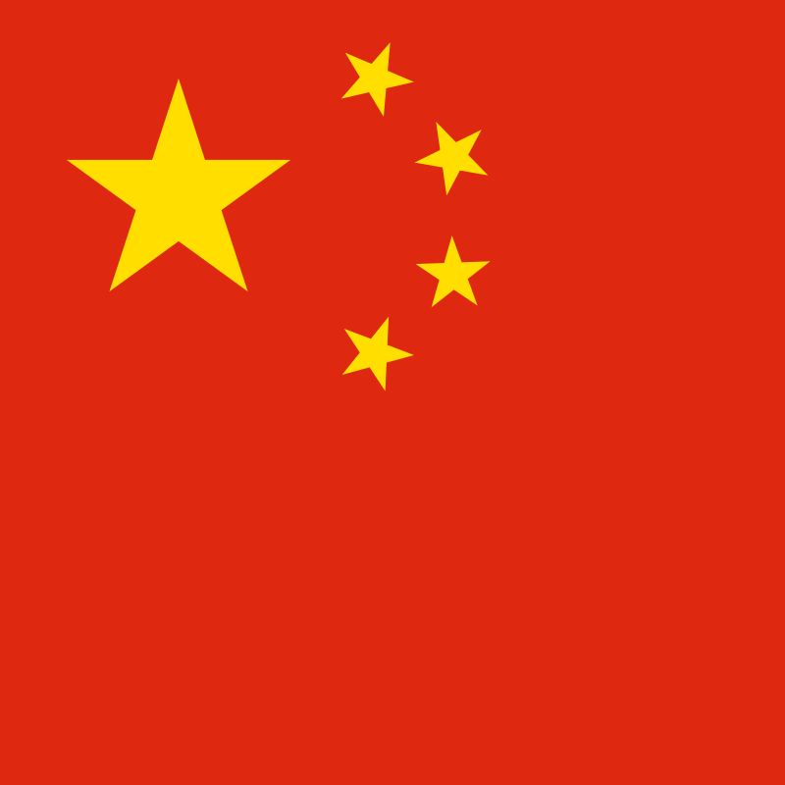
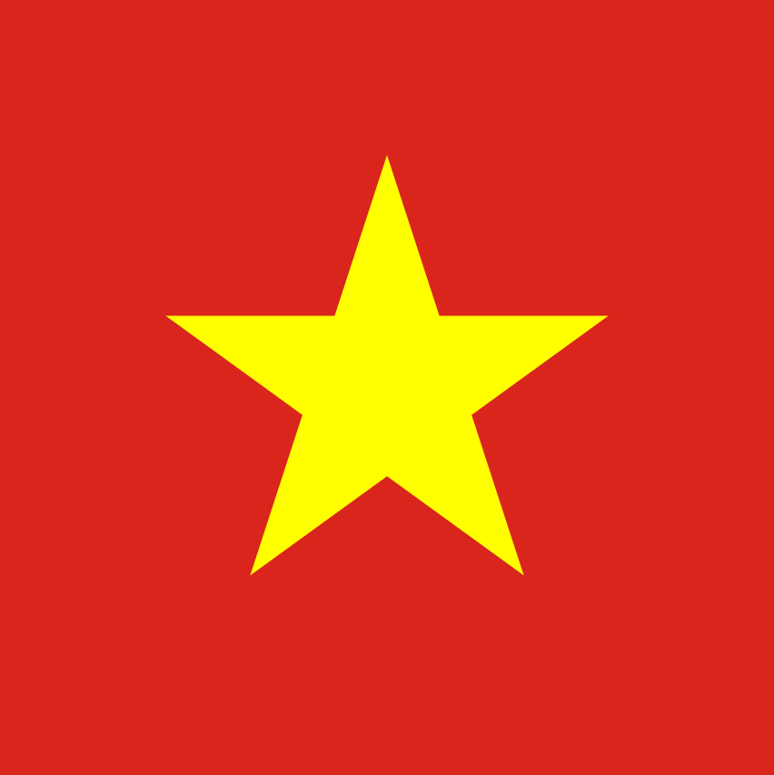
KNRTU International Partners
72
Agreements
66
Educational, Research and Business Organizations
17
Countries
12

Slide 13
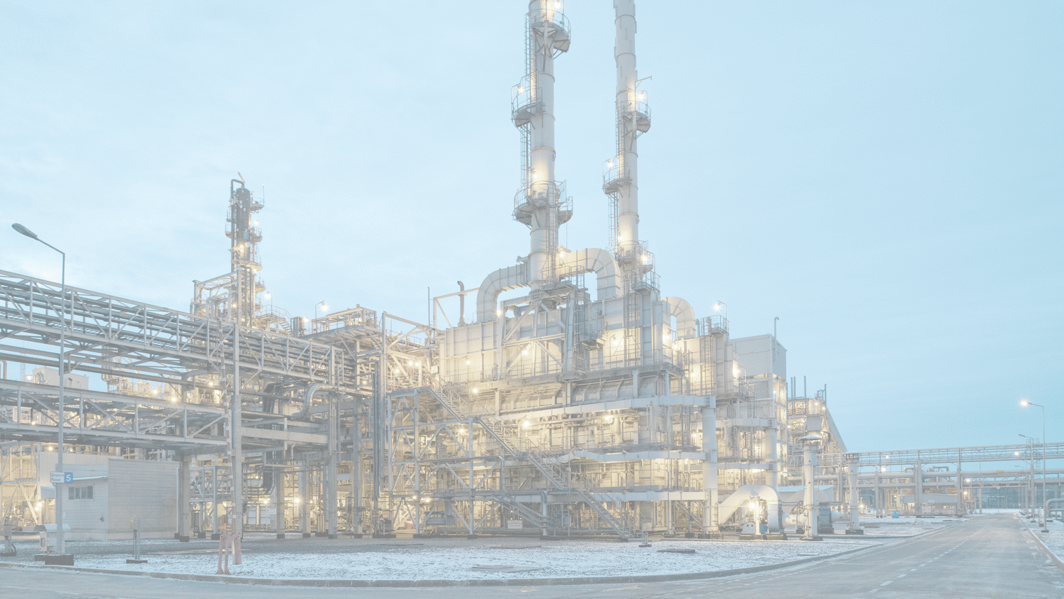
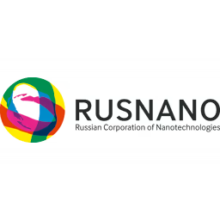
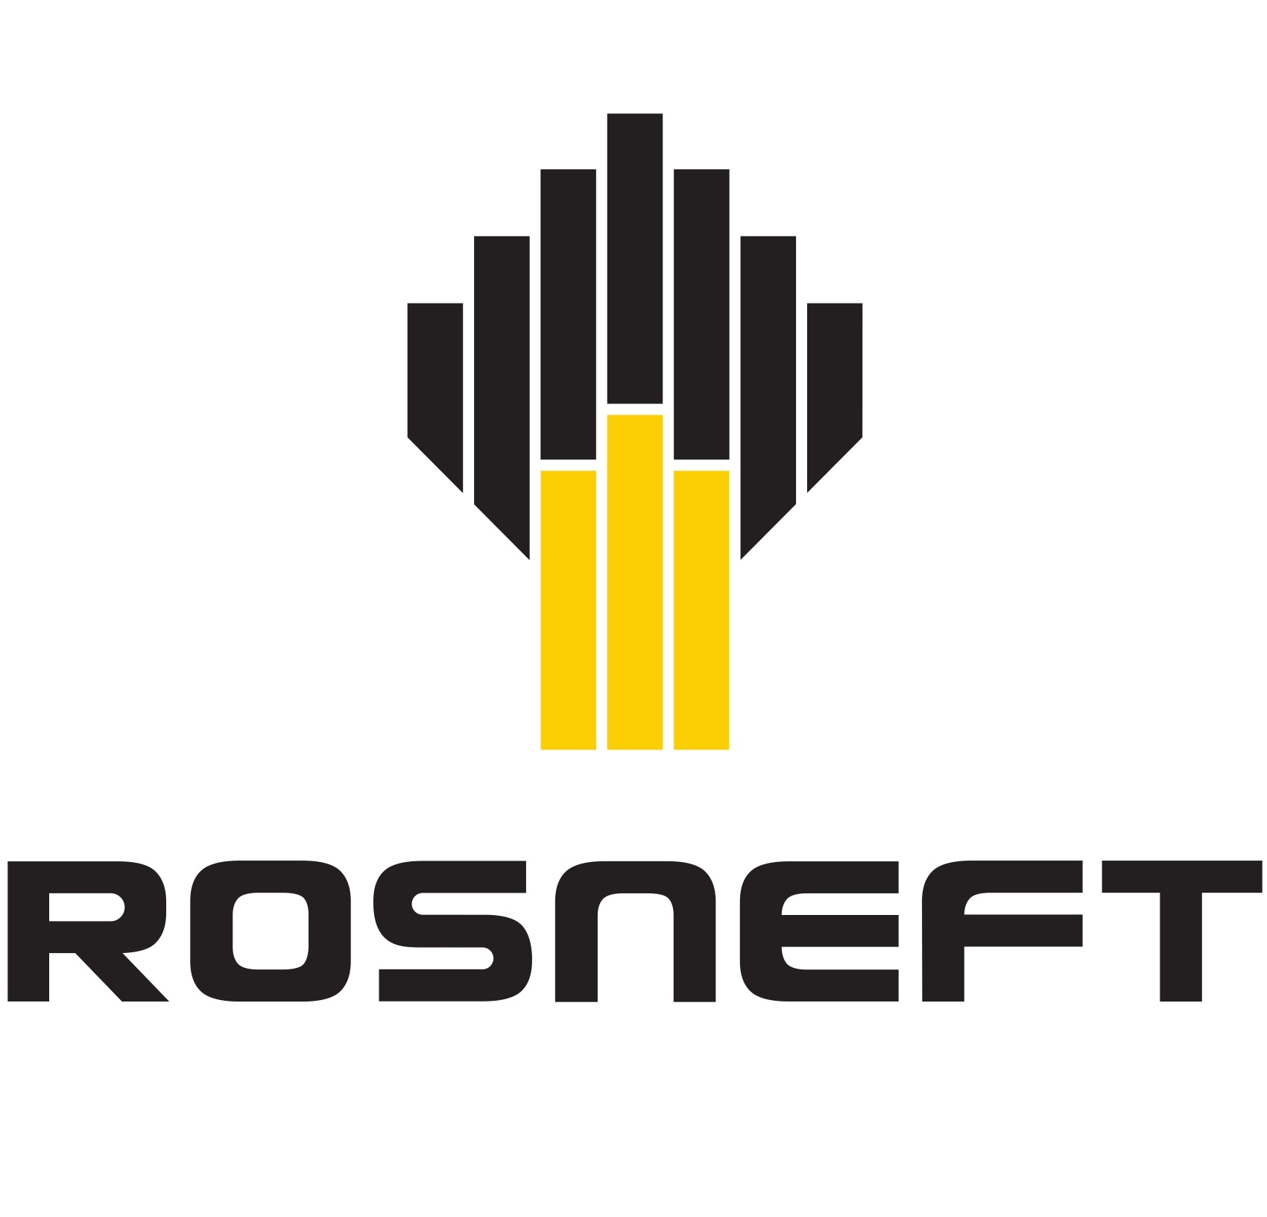
KNRTU Key Industrial Partners
TATNEFTEKHIMINVEST-HOLDING
13

Slide 14
KAZAN NATIONAL RESEARCH TECHNOLOGICAL UNIVERSITY
Contact Us:
International Affairs
Tel.: 231-43-19
E-mail: inter@kstu.ru
www.kstu.ru/knrtu/
68 Karl Marx street
Kazan 420015
Republic of Tatarstan

